Slide 1
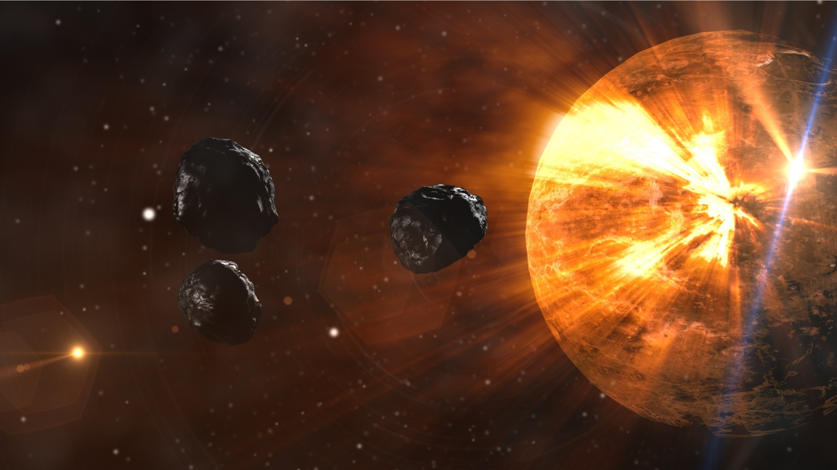
Meteorite Landings
ANALYTICAL PROJECT PRESENTED BY:
SHRUTI D
EMMA HOLTGRIEVE
LYUDMILA DEVLYSH

Slide 2
TABLE OF CONTENTS
Introduction
What are Meteors and Meteorites
Examples
Antarctica Research
Meteorite Data Analysis
01

Slide 3
INTRODUCTION
Meteorites are much more than just space rocks, they can provide us with crucial information about everything from solar system formation to the origins of life on Earth (American Museum of Natural History, n.d.). Furthermore, according to the Planetary Science Institute, approximately 500 meteorites land on the Earth’s surface every year with only 10 recovered (Planetary Science Institute, 2019). This approximation tells us that there must be plenty of meteorites still to be discovered, which means there’s still lots of insights yet to be made from meteorites. These factors are what inspired us to pursue this project.
The goal of this project is to identify the frequency of meteorite landings throughout different time periods, most common geographic regions of meteorites, and the differences between meteorite landings in the northern and southern hemispheres respectively. The goal of this project would be an analytical pipeline to identify trends in meteorite landings and their respective geographical locations.
02

Slide 4
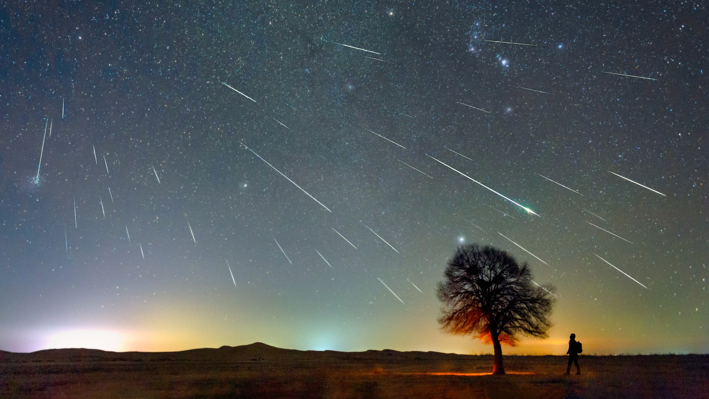
WHAT ARE
METEORS AND METEORITES?
A meteorite is a solid piece of debris from an object, such as a comet, asteroid, or meteoroid, that originates in outer space and survives its passage through the atmosphere to reach the surface of a planet or moon. When the original object enters the atmosphere, various factors such as friction, pressure, and chemical interactions with the atmospheric gases cause it to heat up and radiate energy. It then becomes a meteor and forms a fireball, also known as a shooting star; astronomers call the brightest examples "bolides". Once it settles on the larger body's surface, the meteor becomes a meteorite. Meteorites vary greatly in size. For geologists, a bolide is a meteorite large enough to create an impact crater.
The Greek root for both meteor and meteorite is ta meteora, "things in heaven above."
Credit: https://en.wikipedia.org/wiki/Meteorite
04

Slide 5
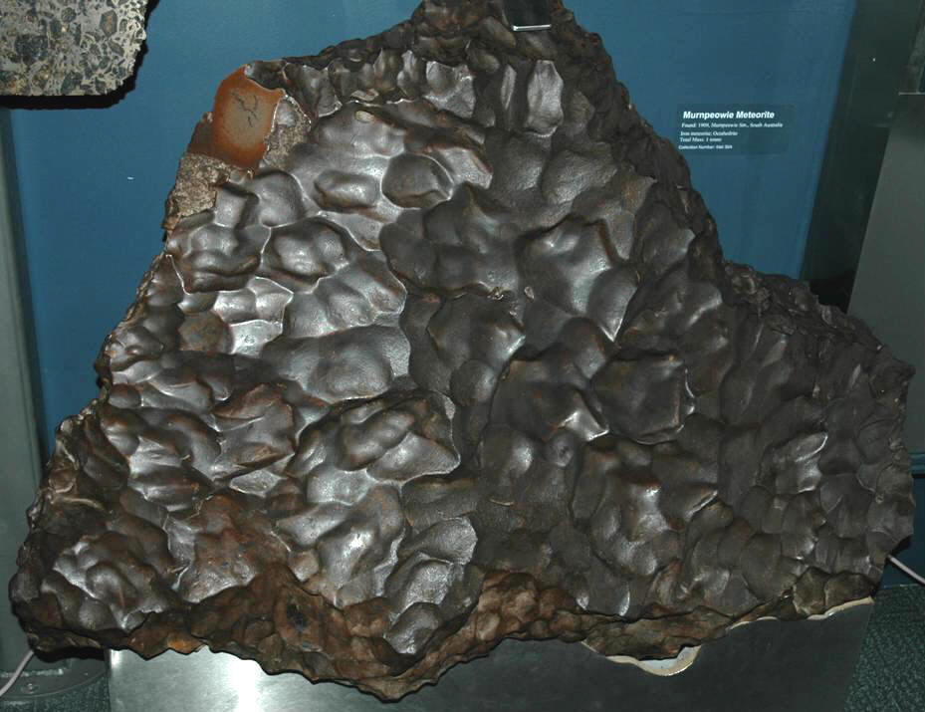
EXAMPLE
Murnpeowie Meteorite - this spectacular, 2520-pound iron meteorite was found in the South Australian Outback in 1909. The mass has a well-preserved, dark-colored, outer surface with nice regmaglypts (surface cavities). Iron meteorites exposed at Earth's surface oxidize & rust relatively quickly. Given the fresh nature of Murnpeowie, it's been estimated that it fell to Earth within five years of it being found.
Location: South Australian Outback between Lake Callabonna and Lake Blanche, NE by E of Mt. Hopeless, near the Strzelecki Track, eastern South Australia.

Slide 6
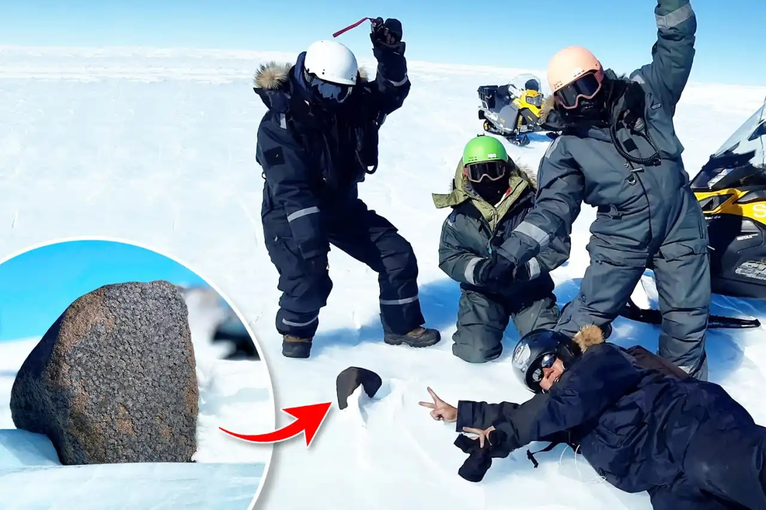
ANTARCTICA RESERACH
2/3 of all meteorites found come from Antarctica.
There is a reason why it is hard to find meteorites.
For starters, 2/3 of Earth is covered with water. For all the meteorites that make it to Earth, most of them splash down the oceanic obscurity.
To be discovered and studied, meteorites have to land on land. But over 100s of thousands of years meteorites eroded by the elements.
Dry places however present better grounds for preservation of meteorites. So, most are found in the deserts.
And the biggest desert in the world is Antarctica.

Slide 7
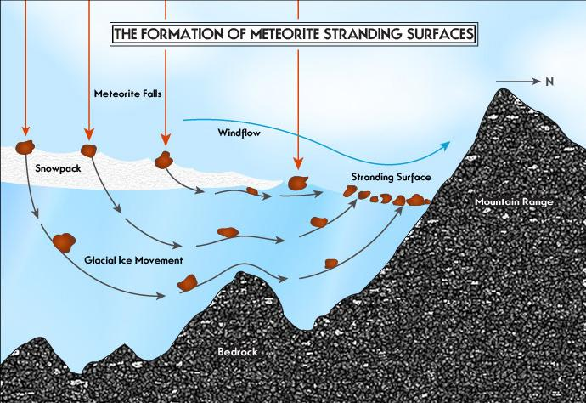
ANTARCTICA RESEARCH continued
But we don’t find space rocks just anywhere in Antarctica. That is because meteorites that land there, end up landing on glaciers. And over time more and more ice piles on top of meteorites. Glaciers start flowing like giant frozen rivers, carrying meteorites with them. Most glaciers flow straight into the ocean. But some collide with mountains, forcing the ice upward. Meanwhile strong winds shear away the highest part of the glacier, reviling deeper ice and thousands of years of deposited meteorites. So, Antarctica is perfectly primed to collect meteorites. It catches them with its huge surface area, keeps them on ice and piles them in the specific places. Those meteorites have been compressed for so many years, that all the air is squeezed out of them. They literally appear blue in sunlight once reached the surface. All scientists have to do is find blue ice and collect the meteorites.
Over 67000 discovered and documented meteorites, over 42000 have been collected in Antarctica. And each year expeditions bring nearly 1000 more.

Slide 8
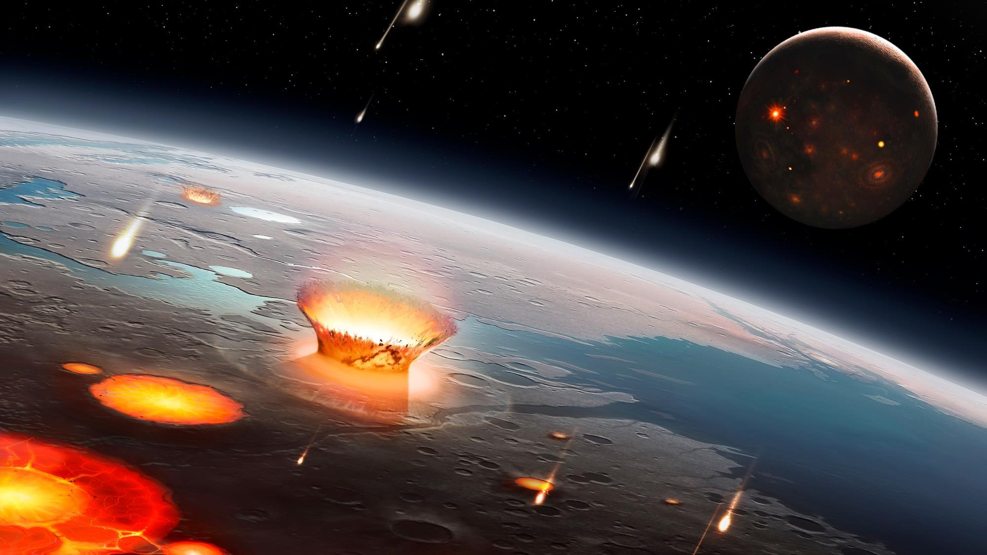
ANTARCTICA RESEARCH continued
The research of meteorites gives us information to study how the planets evolve, and even the Moon came to be. How meteorites might’ve brough water to Earth. As well as the organic molecules that life possible on our planet.
However, the meteorites in research are the tip of the iceberg and probably represent about 13% of the space rocks locked in the Antarctica. So there is plenty of secrets still locked in the glaciers of Antarctica.
CREDIT: https://www.youtube.com/watch?v=3NUUNo43b3A

Slide 9
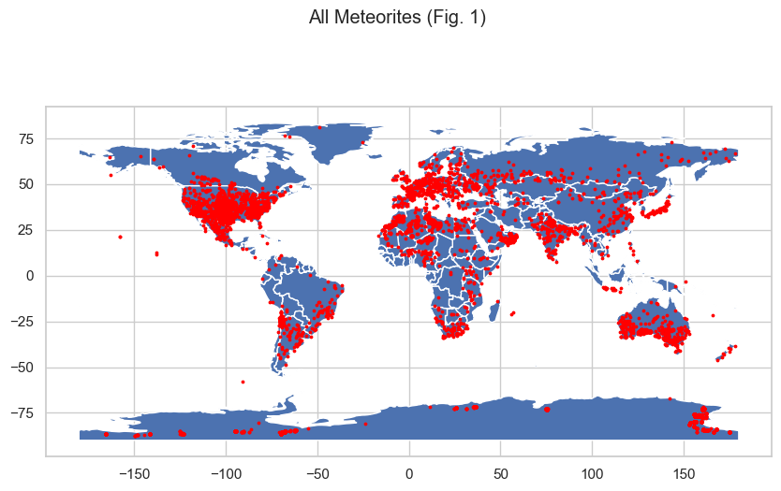
TEAM ANALYSIS
The data used for this project was obtained from NASA resource at:
https://data.nasa.gov/Space-Science/Meteorite-Landings/gh4g-9sfh.
Tools used to process the data:
Data clean up in Python.
Graph representations showing geo location of falling of recorded meteorites; number of recorded meteorites per year; top 50 heaviest classes of recorded fallen meteorites.
Used d3, Leaflet, GeoPandas, Plotly, Plotly Express JavaScript, HTML and Postgres.

Slide 10
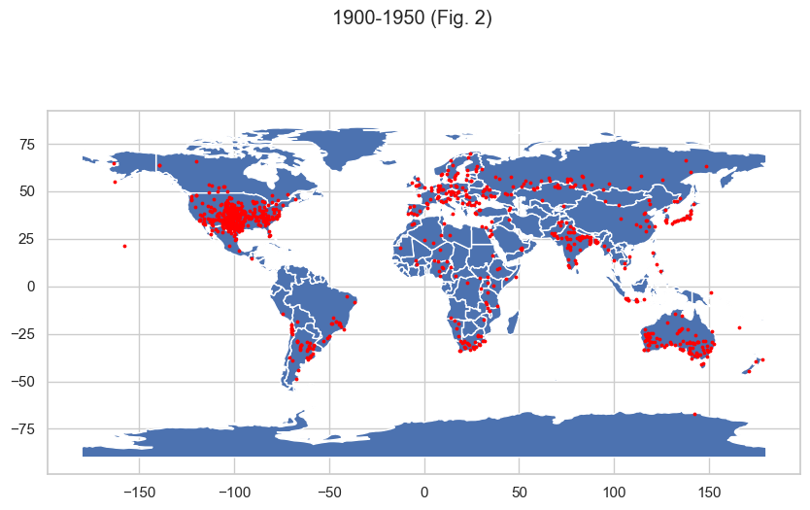
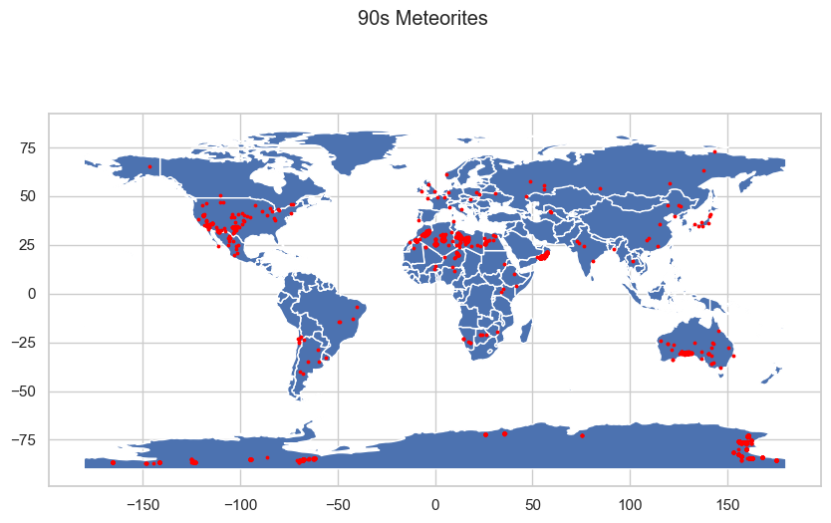
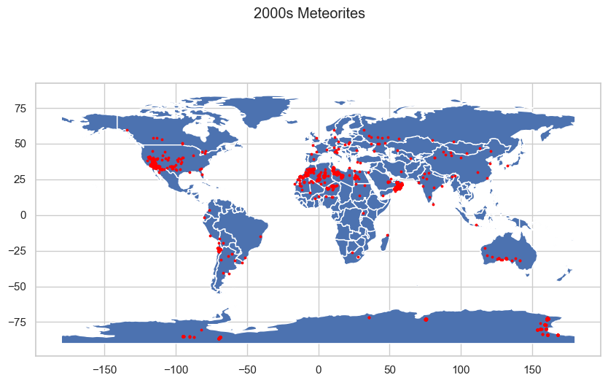
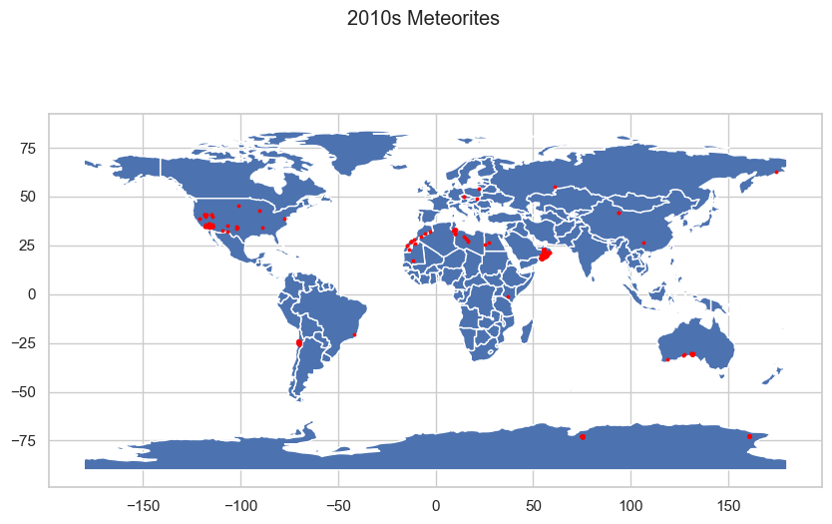

Slide 11
Key Points As we can see from the analysis done above, there are some notable points that we have learned from this dataset.
1998 had the highest frequency of meteorite landings, while 2013 had the least in the last three decades. 1937 had the highest frequency of meteorite landings, while 1901 had the least in the early 1900s. There's a general trend of meteorites landing in the western US, Southern America, Norther Africa, Southern Australia, and parts of Europe. Another point to notice is , there seem to be less meteorites in the 2010s than in the other decades. It might be difficult to sight because of population density .

